Slide 1
Designing Effective Surveys

Slide 2
Where to Start
What is your purpose statement?
What do you want to know?
Every decision you make in survey design should be framed by the two questions above.
Pin your purpose statement up over your computer.

Slide 3
When to Use Surveys
No one likes to fill out surveys.
  Waste of time
  Documentation of statements
Use surveys when you cannot gather data directly.
  Too many people; too far away
Use surveys when it is important that you gather data consistently.
  Ability to compare responses based on established criteria
    Pre-assigned coding categories
    Use of statistical analysis

Slide 4
When Not to Use Surveys
There are only a few respondents in your study.
You need to ask follow-up questions.
There is a key respondent from whom you must gather data.
You do not know the construct around which you are gathering data.
You are using constant comparative data analysis.
You need lots of data from each respondent.

Slide 5
Survey Research
Gathering Self-Report Data
The art of getting people to give you accurate information

Slide 6
All Questions are Biased
Well, you should think this way.
Bias is a systematic error introduced into surveys by encouraging one answer over others.
Put another way, bias appears when respondents either cannot or will not give you accurate information.
Bias in surveys consistently appears in a few common ways.

Slide 7
Language
Questions need to be designed so that every respondent interprets the question in exactly the same way.
Of course this will never happen but there are ways to minimize misinterpretation.
This applies to both the questions and the response categories.

Slide 8
Write the questions to the language level of the respondents
Eliminate plagiarism. (high school?)
Do not allow copying. (4th grade)
When in doubt choose simpler terms.
Use the readability statistics in Word.
Or: https://readability-score.com/
  Gunning fog index

Slide 9
Language: Sentence Complexity
Do you agree that inservice training should focus on the standards and expectations stated in recent publications distributed by the Council of Chief State School Officers surrounding teacher evaluation related to advancement?
  Gunning Fog—21.55
  Flesch Reading Ease—5.16

Slide 10
Language:
Jargon and Uncommon Words
With cooperative learning, round-robin brainstorming should include anticipatory sets.
An effective math strategy might include dactylonomy.

Slide 11
Language: Ambiguous Terms
Do you approve of children watching violence on television?
How often do you exercise?
  Regularly
  Occasionally
Absolutes are always ambiguous.
Spell out acronyms, even if you have spelled them out previously.

Slide 12
Language: Double-Barreled Questions
Avoid the word and.
Question 1—Rate the following:
Acquiring knowledge and practicing skills relating to information and technology literacy.

Slide 13
Language: The Word Not
Question 1—Do you agree or disagree?
Cooperative learning is not my first choice of instructional strategies.
Write questions positively even when you mean the opposite.
I make choices other than cooperative learning when designing instruction.

Slide 14
Language: Leading Questions
Do you employ project-based instructional strategies such as service learning?
Do student scores increase when you use project-based learning?

Slide 15
Language: Norms and Intrusiveness
Do you believe that all children can learn?
Have you ever violated a district policy?

Slide 16
Language
Even well-worded questions often have the bias
of assuming common experience and language.
Which object’s name begins with the letter I?

Slide 17
Language
Survey questions must be grammatically prefect.
When in doubt use a simpler structure to assure correctness.
Use punctuation correctly and consistently.

Slide 18
All Questions are Biased
Review every question you write.
  Can you imagine that the way you have asked a question makes it so that a respondent cannot or will not give you accurate information?
  Look for implied correct responses in the way you wrote the question.
  Look for reasons respondents might not answer the question at all.

Slide 19
Practice
Sample Survey I

Slide 20
Duckworth, A. (2016). Grit: The power of passion and persistence. New York, NY: Scribner.

Slide 21
Survey Layout

Slide 22
Design-Based Response Error
The visual design of surveys impacts how people respond.
Most of this applies to both paper-based and electronic surveys but the solutions look a bit different depending on the medium.
This is mostly Dillman
Dillman, D. A., Smyth, J. D., & Christian, L. M. (2014). Internet, phone, mail and mixed-mode surveys: The tailored design method. (4th ed.). Hoboken, NJ: Wiley.

Slide 23
Question Stems and Answers
Question stems should be clearly distinguishable from the answer choices usually through the use of larger or darker type.
3. How often do you study for this class?
☐ Daily
☐ Weekly
☐ Monthly
☐ Once a semester
3. How often do you study for this class?
☐ Daily
☐ Weekly
☐ Monthly
☐ Once a semester

Slide 24
Question Stems and Answers
Standardize spacing
3. How often do you study for this class?
☐ Daily
☐ Weekly
☐ Monthly
☐ Once a semester
3. How often do you study for this class?
☐ Daily
☐ Weekly
☐ Monthly
☐ Once a semester
☐ I choose not to answer

Slide 25
Question Stems and Answers
Standardize spacing
3. How often do you study for this class?
☐ Daily—more than once
a week
☐ Weekly
☐ Monthly
☐ Once a semester
3. How often do you study for this class?
☐ Daily—more than once
a week
☐ Weekly
☐ Monthly
☐ Once a semester

Slide 26
Question Stems and Answers
Emphasis in stems
  Avoid emphasis if possible
  If used, make sure the emphasis is obvious
    Bold is usually not obvious
3. Select one answer that best represents how often you study for this class?
☐ Daily
☐ Weekly
☐ Monthly
☐ Once a semester

Slide 27
Underlining
This is appropriate
This is inappropriate
drawn rule
underlining
Do not use underlining with web-based surveys because it implies a link.

Slide 28
Question Stems and Answers
Response spaces communicate how to respond
4. Descibe your study habits for this class.
4. Descibe your study habits for this class.

Slide 29
Question Stems and Answers
Response spaces communicate how to respond
  The special case of the expanding textbox
4. Descibe your study habits for this class.

Slide 30
Response Category Alignment
5. Overall how would you rate the quality of this course?
☐ Excellent
☐ Very Good
☐ Good
☐ Fair
☐ Poor
5. Overall how would you rate the quality of this course?
☐ Excellent
☐ Good
☐ Poor
☐ Very Good
☐ Fair

Slide 31
Response Category Alignment
5. Overall how would you rate the quality of this course?
☐ Excellent
☐ Very Good
☐ Good
☐ Fair
☐ Poor

Slide 32
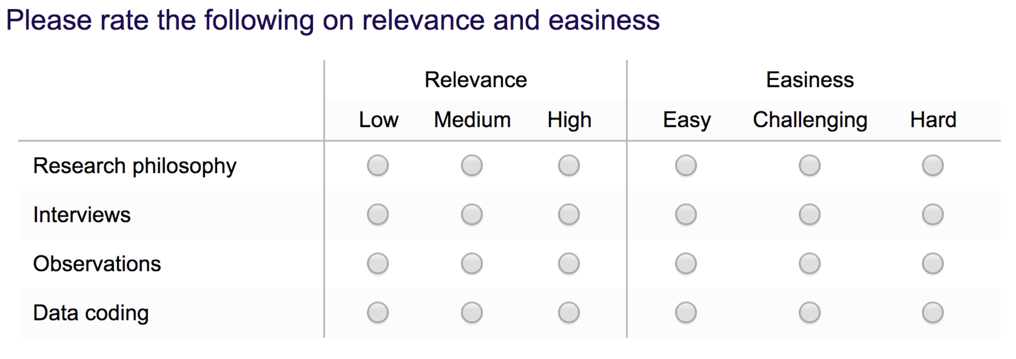
Avoid Side by Side

Slide 33
Question Order
Group related questions together.
Make the first question clear and relevant to all respondents—get them interested.
Sensitive questions should go near the end.
Unintended order effects
  (Cognitive) Early questions influence cognitive processing of later questions
  (Normative) Early questions evoke social norms that carry forward to later questions

Slide 34
Order Effects—Cognitive
Agree to Disagree response scale:
5. I use cooperative learning to improve student interactions in the classroom.
17. In science instruction, cooperative learning is an effective instructional strategy.

Slide 35
Order Effects—Normative
Agree to Disagree response scale:
3. All children can learn.
19. Family problems make learning difficult for some learners.

Slide 36
Survey Layout
Lots of white space. Cute is generally a bad idea.
Front sides only with paper surveys.
Do not use blank spaces in the middle of questions.
  17. I drink ___ cups of coffee per day.
Most surveys begin with demographic questions.
  Ask all of the demographic questions you need but no more.

Slide 37
Read Survey Bias

Slide 38
Practice
Sample Survey II

Slide 39
Quantitative Surveys

Slide 40
Quantitative or Qualitative
Surveys are quantitative when the analysis will be inferential
Surveys are qualitative when the analysis will be qualitative.
If numbers are gathered and analyzed qualitatively, it is called a descriptive study.

Slide 41
Response Categories
Response categories must encompass all possible responses. (exhaustive)
Respondents must be able to clearly distinguish among response categories. (mutually exclusive)

Slide 42
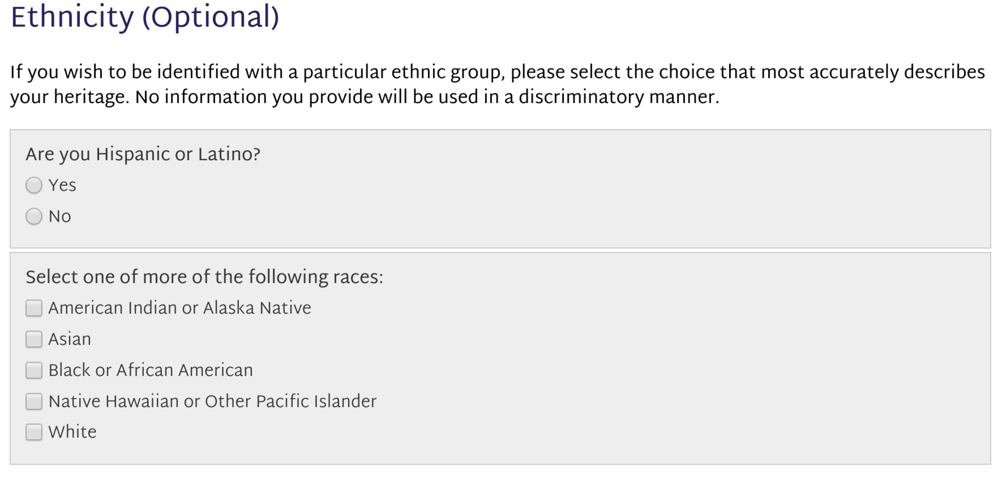
Exhaustive and Mutually Exclusive

Slide 43
Response Categories
Normally listed positive to negative but research may suggest otherwise.
Decide about center responses.
  What does the center response mean?
    I don’t know how to answer or my belief is neutral
  Use Don’t Know response categories as little as possible.

Slide 44
Survey Content
Most surveys are designed to gather data about:
Demographics
How many years have you been teaching?
Behaviors
How do you deal with students who are off-task?
Attitudes or Opinions
Are your students receiving sufficient parental support?
IRB: Is it possible that the answer to any of these questions might cause the respondent harm?

Slide 45
Quantifying Responses
Open-Ended Questions
Questions with Response Categories

Slide 46
Survey Analysis Types
Nominal/Ordinal Data
  chi square: are counts within categories likely to have occurred by chance?
    Does not allow looking at the relationship of independent and dependent variables.
Interval Data
  analysis of variance: are group mean differences likely to have occurred by chance?
    Greater ability to focus on impact of intervention

Slide 47
Quantifying Opinions
Since surveys are by definition self-report data, most surveys are designed to gather opinion data.
Since opinion data are by definition subjective, quantifying survey data is difficult.
All respondents must interpret the questions in the same way.
All respondents must interpret the response categories in the same way.

Slide 48
Quantifying Opinions
The general strategy is to get respondents to place themselves on a provided response continuum.
Using a continuum improves the ability to represent an opinion on an interval scale.
This strategy violates lots of basic statistical assumptions.
Our job is to mitigate those violations.

Slide 49
Interval Scales
Equal Spaced Response Categories
Designing logical extremes.
  Avoid absolutes
Selecting the number of intermediate responses.
Design responses as symmetrical.
Label all response categories.

Slide 50
Interval Scales
Equal Spaced Response Categories
These are still really ordinal data.
Possible bias that appears from using ordinal response categories is minimized when multiple question around a given construct are analyzed simultaneously.
Analyze as a group first then as individual questions if you have to.
  Multivariate then univariate

Slide 51
Content Design Issues
Data degradation (Interval)
  Gather the most detailed information that you will possibly need
  How detailed are respondents willing to be?
Data comprehensiveness
  Ask everything you need to ask but no more
Multiple questions around issues

Slide 52
Quantitative Survey Research
(Turning perceptions into numbers)
Indices
Scales
Semantic Differentials
Likert Scales

Slide 53
Index
Counts responses within a category
If the things being counted are equivalent then index can be considered interval
(mode, median or mean)
Instructions are select all that apply

Slide 54
Index
2. Have you read the following? (select all that apply)
A Public Trust at Risk: The Heritage Health Index Report booklet
Case studies on this website
Resource page on this website
The Heritage Health Index Full Report (PDF file on this website)
Other page(s) on this website
None of the above
4. Do you plan to share the information from the Heritage Health Index with any of the following? (select all that apply)
Colleagues at your institution
Colleagues in your field
Professional organizations
Foundations or other funders
Media
Institutional leadership/governing body
Federal government officials or legislators
State government officials or legislators
Local government officials or legislators
Other

Slide 55
Index
What device(s) do you use to access the Internet? (Select all that apply)
Desktop computer
Laptop computer
Tablet (e.g. Surface, Apple iPad, Android, etc.)
Smartphone (e.g. Apple iPhone, Android, RIM/Blackberry, Windows Phone 8, etc.)
e-book reader/e-reader (e.g. Nook or Kindle)
Digital music player (e.g. iPod, MP3 player, etc.)
Gaming device (e.g. Xbox, Wii, PSP, etc.)
Other

Slide 56
Self-Coding Index
Please report the number of different grade levels at which you have taught.

Slide 57
Scales
Respondent selects one answer from a list which represents increasing levels of a single characteristic.
Usually ordinal information
(mode or median)
Only one response can be selected

Slide 58
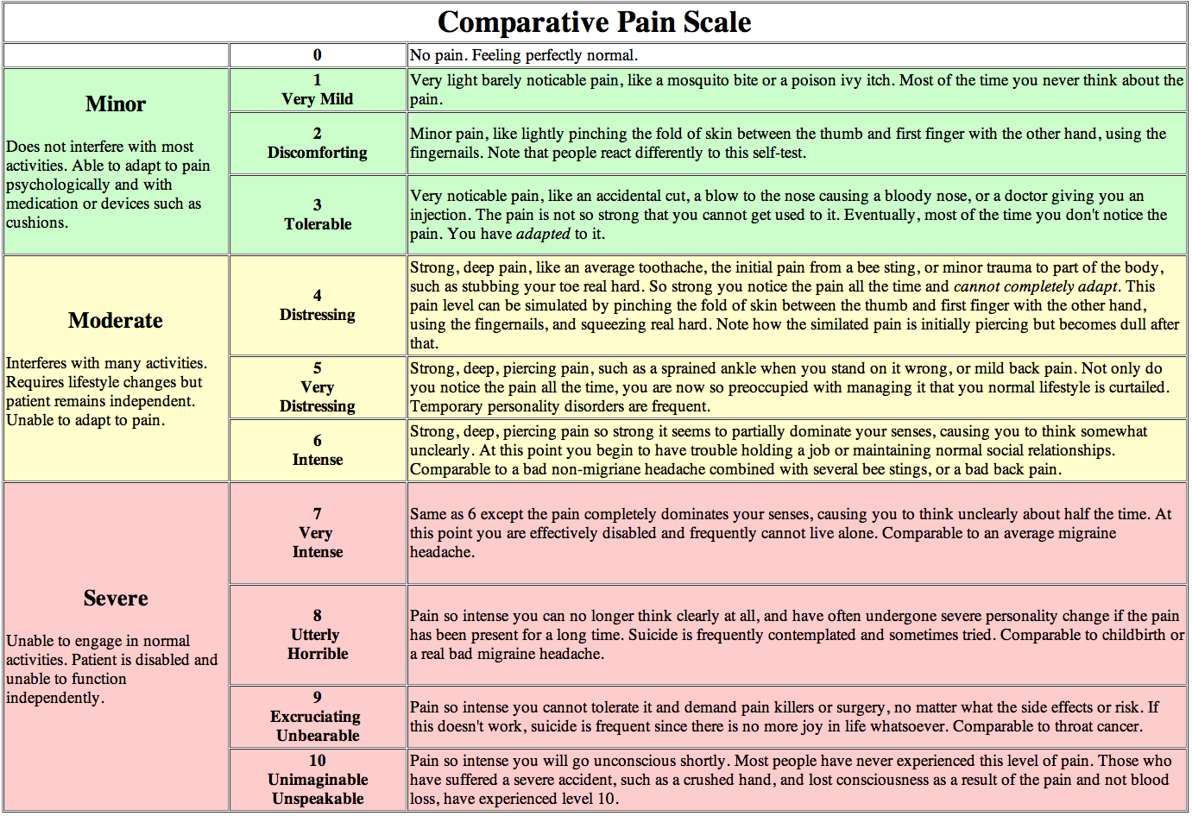

Slide 59
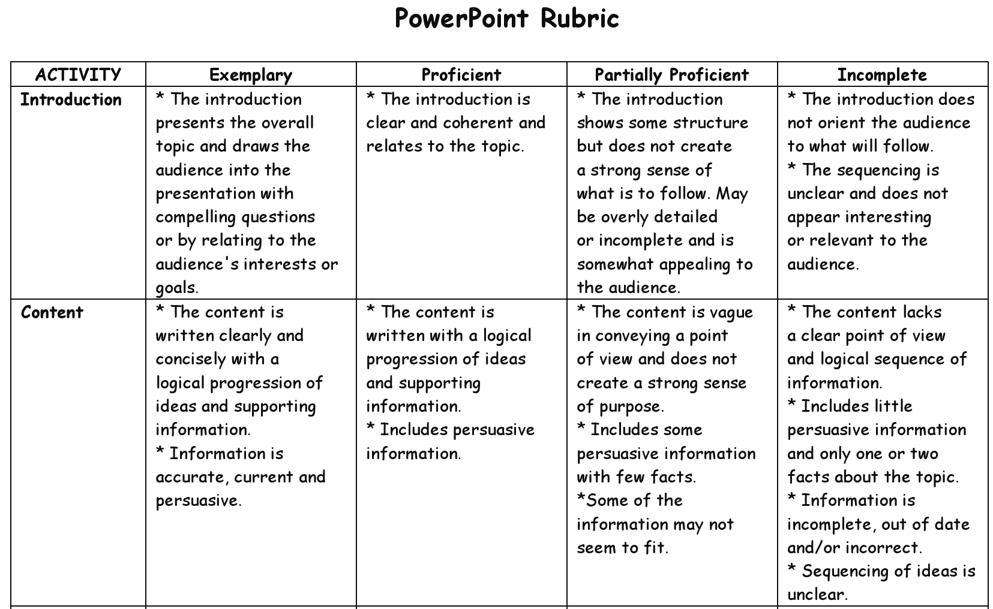

Slide 60
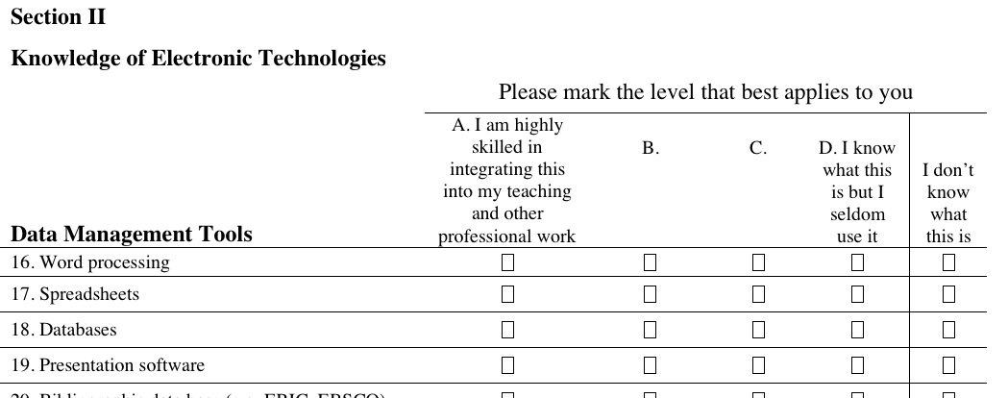

Slide 61
Please select the category which best represents your family income.
0 – $10,000
$10,001 – $20,000
$20,001 – $30,000
$30,001 – $40,000
$40,001 – $50,000
$50,001 – $60,000
$60,001 – $70,000
$70,001 – $80,000
$80,001 – $90,000
$90,001 – $100,000
And more …

Slide 62
Semantic Differential
Selection of a point on a continuum anchored by opposites
Sometimes designed as forced choice scales
Difficult to design with any reliability

Slide 63
Coffee Preferences
Semantic Differential
I like my coffee:
boiling hot ice cold
I prefer coffee in a:
tiny cup gallon jar
In terms of sweetness, I prefer:
no sugar 50% sugar
0 1 2 3 4 5

Slide 64
Semantic Differential
(forced choice)
Circle the choice that best identifies you.
I consider myself old young
I am fit unfit
I prefer salads meat
For entertainment I stay home go out
Calisthenics are exhilarating depressing

Slide 65
Please choose the statement that best describes you
Given a choice I would live in a log cabin.
Given a choice I would live in a condominium.

Slide 66
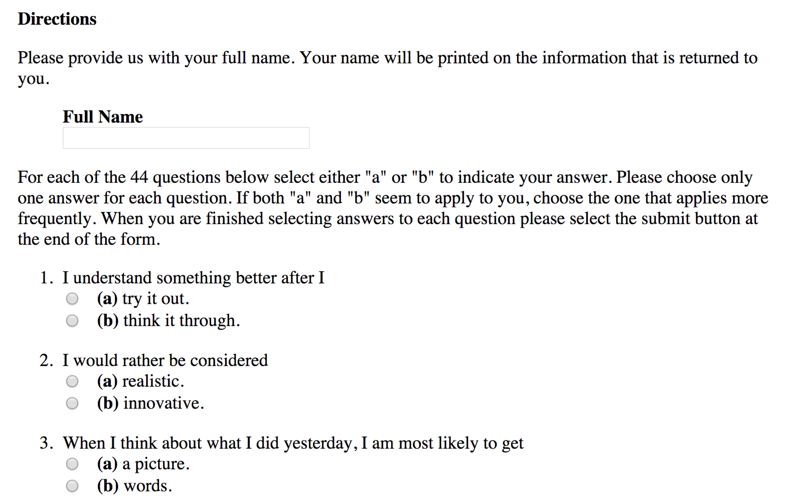
Index of Learning Styles Questionnaire
Barbara A. Soloman
Richard M. Felder
North Carolina State University

Slide 67
Likert Scales
Almost always assessment of attitude or opinion
Anchors on the scale remain constant through the instrument
Usually agree and disagree
Intermediate points should be labeled
Scale points are symmetrical
Likert, R. (1974). A method of constructing an attitude scale. In G. M. Maranell (Ed.) Scaling: A sourcebook for behavioural scientists, 233-243. New Brunswick, NJ: Aldine Transaction.

Slide 68
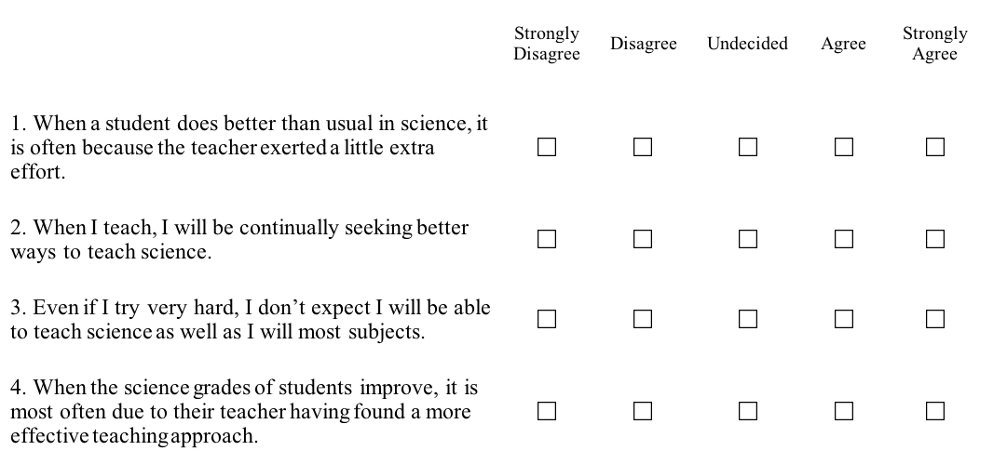
Science Teaching Self-Efficacy

Slide 69
Analyzing Likert Data
Likert items are ordinal data.
To even out the inconsistencies in the ordinal responses and to be able to report interval data Likert scales always include multiple questions to assess a single construct.
Always talk about the construct assessment (all the items together) before looking at individual items.

Slide 70
Likert-Type Responses
https://www.surveylegend.com/likert-type-scale-responses-examples-with-examples/
(Also on the course resources page)

Slide 71
Testing Interval Design
Reliability (consistency)
  Are responses correlated with each other?
    Kuder-Richardson; Cronbach’s Alpha
  Does the scale encompass the full range of variation in the sample?
    Clumping at the ends or middle of the response scales
    Look at the histogram
Has anyone else tested the instrument?

Slide 72
Design for Analysis
Know what procedures you will use to analyze the data BEFORE designing the instrument.
Use the same scale for all responses if at all possible.
Design questions to be mutually exclusive between sub-issues.
  Test this through correlation.
AVOID QUESTIONS THAT ADDRESS MORE THAN ONE CONCEPT OR ISSUE (NO ANDS).

Slide 73
Steps of Survey Design
If you are not sure what you are trying to find out, then you will not be able to design good questions (theoretical construct). Do the literature work first.
Purpose statement.
Opinion, behavior, and demographic data.
Do instruments already exist?

Slide 74
Question Design
Demographic Questions
  Mutually exclusive and exhaustive
Use the rules for interview question protocols
  Grand tour?
  Design the follow-up questions
Look for bias
If you need detailed answers do not write questions that can be answered simply.

Slide 75
Instrument Design
  Anonymity versus confidentiality
Good instructions are short and clear.
The survey should be easy to complete and short.
Pay attention to question order (Dillman).
Be sure multiple questions do not ask for the same information.
Professional appearance
Space for responses.

Slide 76
A Few More Thoughts About
Question Design
Consider reverse questioning
Consider listing Likert-type scales as Strongly Disagree to Strongly Agree
As a reminder—design for analysis!

Slide 77
Face Validity
Professional appearance
  White space
  Fonts
  Graphics
  Questions one side only

Slide 79
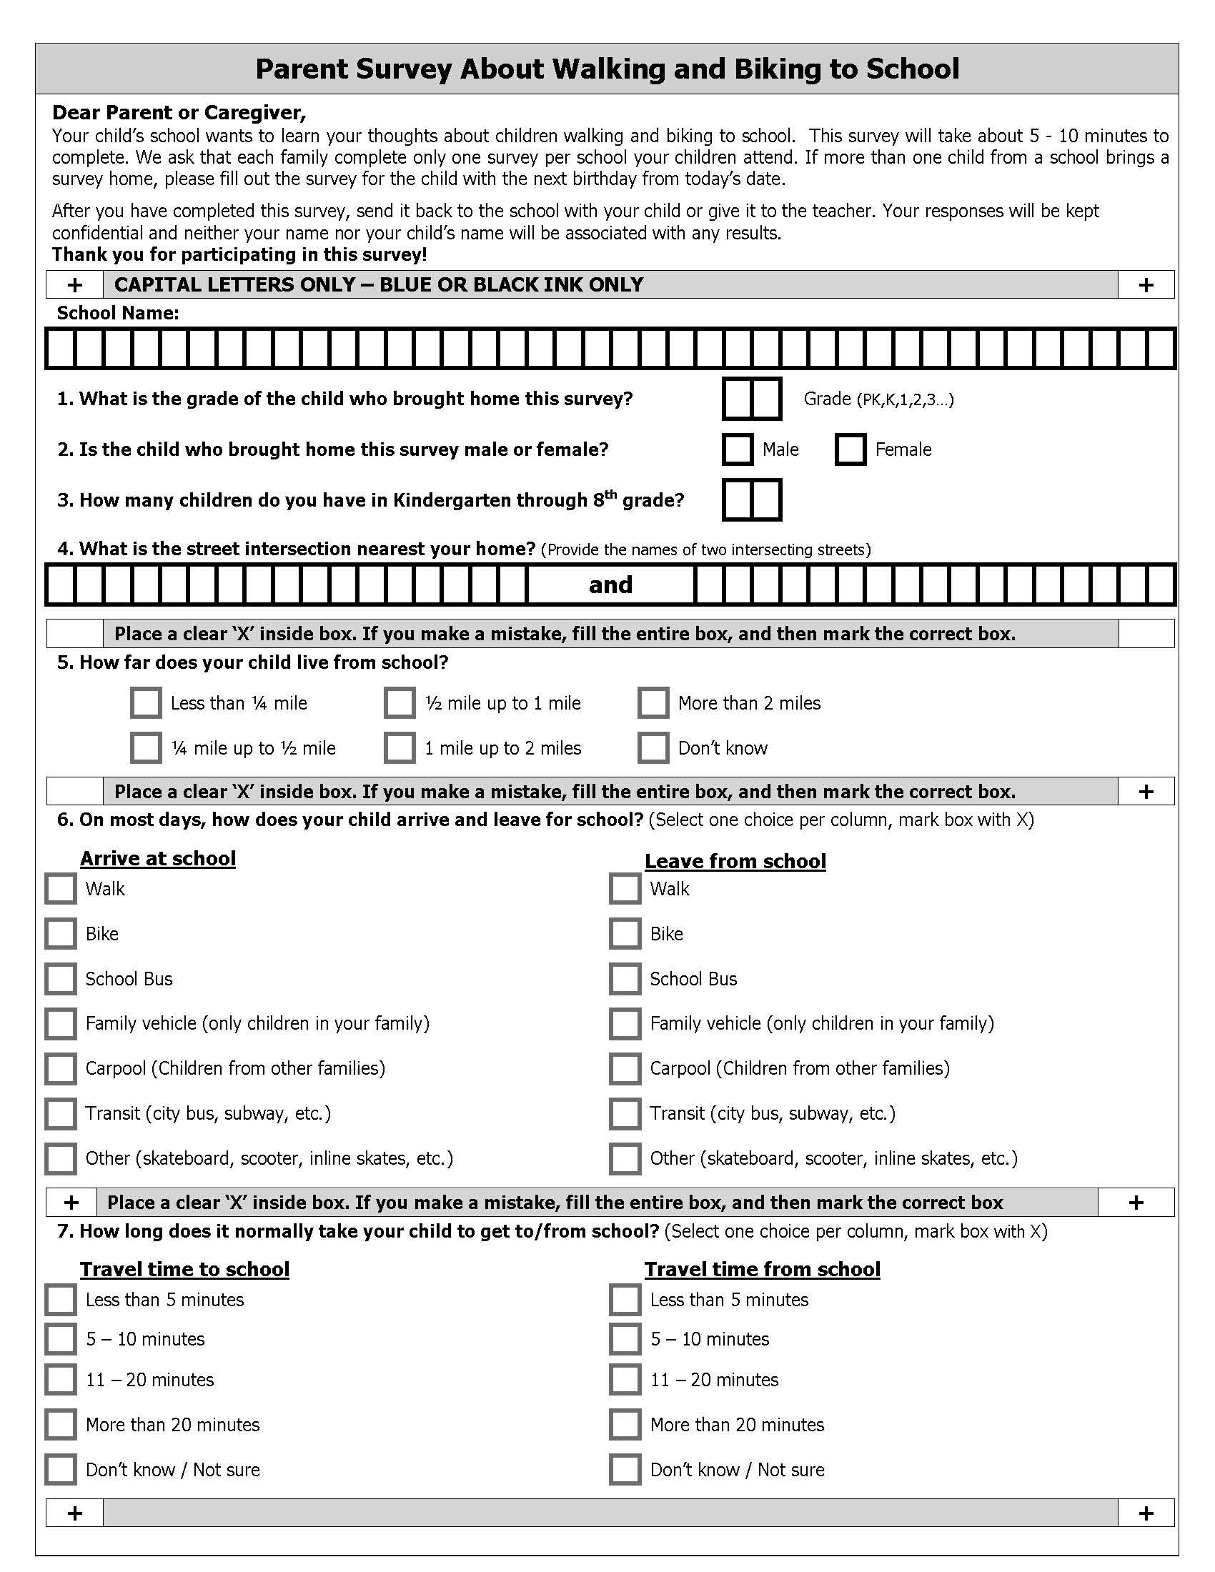

Slide 80
Administering Surveys
Be sure respondents know why they should complete the survey.
  What value will this be to the respondent?
Do you need support from those above you?
How will the surveys be administered?
How will they be returned?
How will you handle non-respondents?

Slide 81
Web-Based Surveys
If you thought paper-based surveys required an inordinate amount of care to produce,
web-based surveys require double that.

Slide 82
Web-Based Surveys
The Rules
Assume that whoever gathers the data will know who the respondents are.
  Be upfront about this
  Figure out how to get people to the survey
  Design for confidentiality
  Ask for names
  Choose a different form of data gathering if these are problems

Slide 83
Web-Based Surveys
The Rules
Who owns the data dictates who has access to the data.
  If you are gathering proprietary or personal information about respondents should it be stored on a commercial server?
  If this is important, then you need to use survey tools that you own or not gather data electronically.

Slide 84
Web-Based Surveys
The Rules
Web-based surveys must look good on the web
  If you do not know how to do this then find someone who can.
  Commercial survey services usually do not give you very much control over appearance. There are exceptions.

Slide 85
Web-Based Surveys
The Rules
Web-based surveys must be easy to complete
  They must function flawlessly on every device, with every operating system, and with every browser (except maybe IE).
  They must be mind-numbingly simple
  They must follow all of the rules of good
  paper-based surveys

Slide 86
Web-Based Surveys
The Rules
Be sure you can control the quality of the data
  Have a way to know if the same person has responded twice
  Do not edit results online

Slide 87
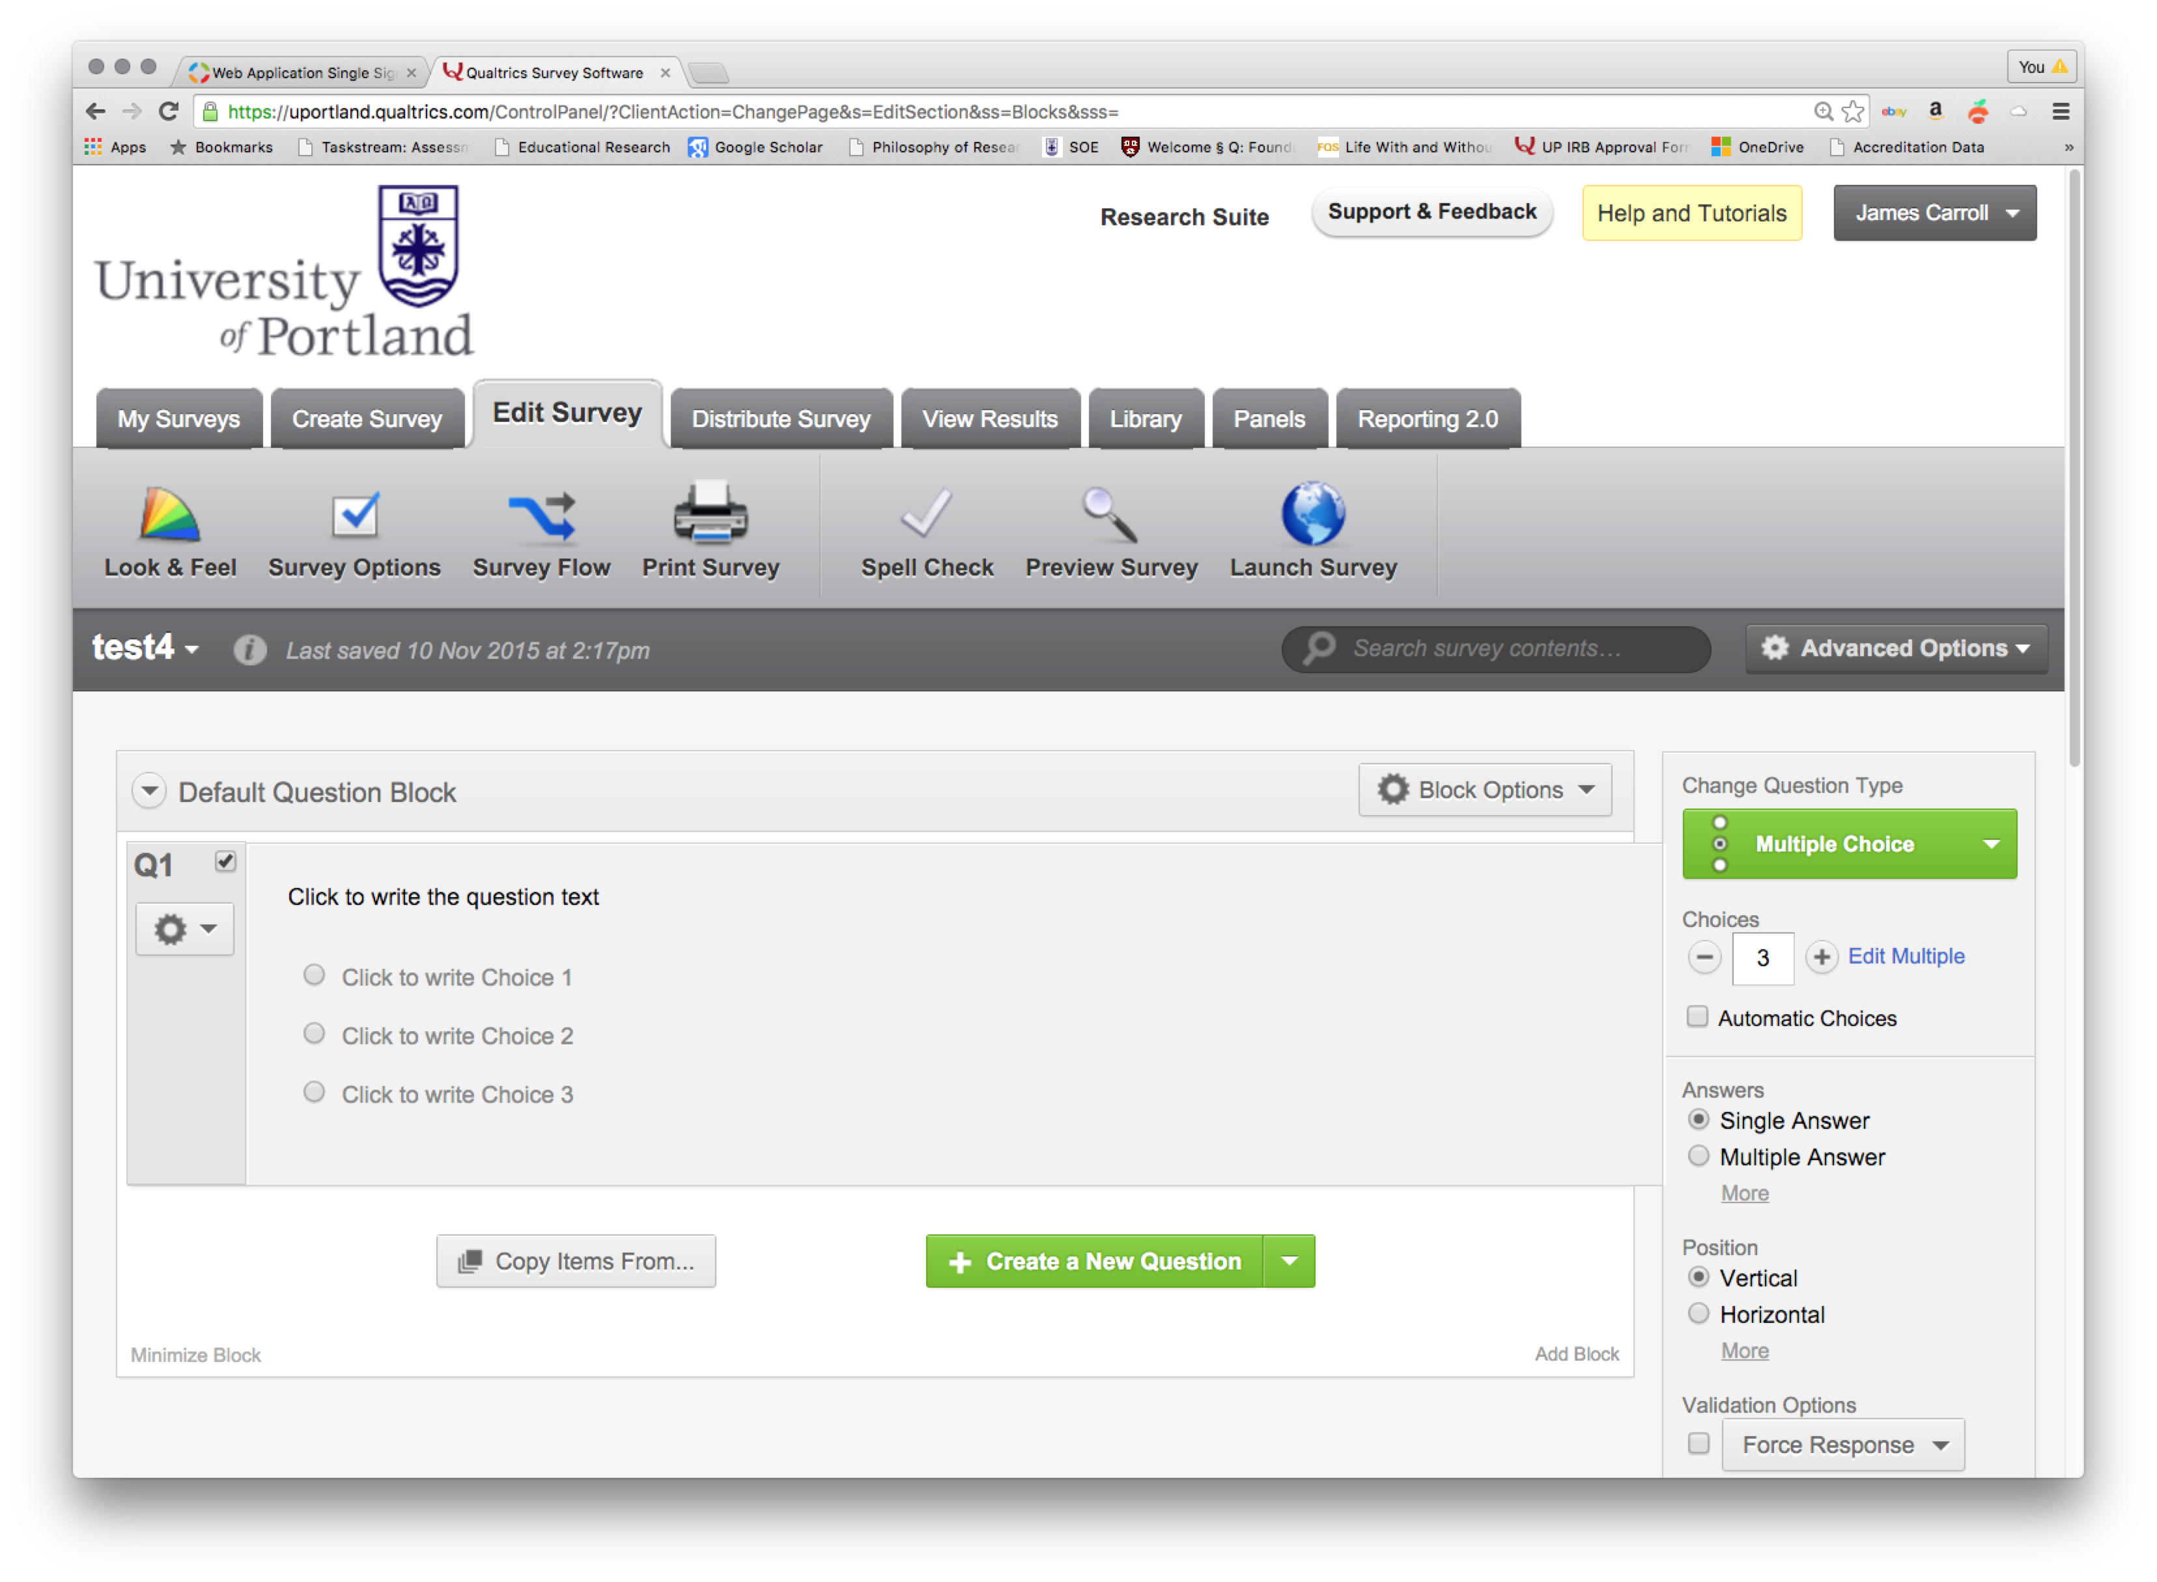
Qualtrics

Slide 88
The last and most important rule that should never ever be violated…
Pilot Test, Including Analysis!

